Slide 1
NVTEC-EA AGM 2024
Annual General Meeting 21st November 2024
Apologies for absence PT
Peter Thorpe to say a few words about Henry PT
Adopt minutes from AGM held 16th November 2023 JW
Chairman’s Report on behalf of Jean & Henry Howlett JW
Secretary’s Report JW
Treasurer’s report and adoption of accounts GC
Memberships Secretary’s Report CM
Cheque Presentation PT/JW
Election of Committee Members PT
Jack/Annie Rally Update JD/AD

Slide 2
NVTEC-EA AGM 2024
Minutes from AGM 16th November 2023
The chair Henry Howlett opened the AGM at 19:30pm and welcomed members and guests to the AGM.
Apologies were received from: Neil Ayres, Jayne Carson, Kate Penn, Ian Cable, Terry Myhill and Reg Fletcher.
Format for the evening had a slight change in that the presentation of Cheques to chosen charities took place before the main AGM business.
David Mycock presented Hugh Mason with a cheque for £2,420.00 raised from the annual working weekend event.
Hugh gave those present a recap on what the Moth in a China Shop (MIACS charity is about – explaining that the charity was set up in memory of his 2 sons as they had lived a good life with the charity offering others a good life with better opportunities too. The charity work is based around the sport of Rugby and the charity aims to find children who need help to become fitter and improve their lives using the sport of Rugby, Northampton Rugby club are involved along with work in Bath and a facility in London where children are coached in enhancing their life.
Hugh thanked the group for invite to this meeting and thanked everyone involved in the weekends activities, Hugh said the amazing knowledge and understanding of our hobby continues to amaze him and he admires this.
A second cheque was due to be presented to Emma in respect of Magpas- the charity chosen to receive the proceeds from Annual Road Run £1,580.00, however Emma was unable to attend so this cheque was forwarded in the post.
Henry read out 2022 AGM minutes, no amendments noted – so Adoption of AGM minutes from 2022 proposed by David Mycock, seconded by Frank Fowler were then signed by chairman Henry Howlett as a true record of the meeting. These minutes will be available on NVTEC-EA website, secretary asked members to inform her if anything did indeed require amending.

Slide 3
NVTEC-EA AGM 2024
Minutes from AGM 16th November 2023
Henry Howlett continued with his chairman’s report in which he gave an overview of the past year of club activities and the challenges faced on the rally weekend, thanking everyone involved in these for their support and hard work and also thanked everyone who continues to support the clubs’ events and who help out in any way. Henry also passed on his condolences to those who have lost loved ones and friends in the past year. Henry also thanked everyone for attending the AGM.
Judy continued with secretary report , Judy thanked Henry for his past years support as chairman and also to Gordon, David Askew, Peter Thorpe and David and Claire Mycock for being the leads on their respective events and membership secretary.
Judy gave an overview of the years events and how successful these had been apart from the Monday of the rally. Goo attendance has been shown at regular committee meetings, club meetings and other club events and shows organised by others.
Judy also explained that this evening members would be required to vote for vice chairman and chairman as another nomination for this role was received and that all committee members will be required to be proposed and seconded to continue for the forthcoming year.
Gordon gave his report which outlined thanks to all involved with the club events, contributions to Vintage Torque and club stands. Gordon thanked Jayne for her support with the Rally and managing the club accounts, she is happy to continue in her role for the forthcoming year but this will be her last year as well. Thanks also given to Bryan and Julie Beba, Jane Loveday, Stephen Watson, Alfred Bagge and his family for their input in to the club and events and giving the club some great publicity (Stephen Watson). Gordon also said the club stand at NEC Birmingham was an amazing but tiring weekend but the stand received astronomical support and interest over the weekend.
Gordon gave some details of the 50 years anniversary of the club plans for 2024 Rally which will be 3 day event including a possible record of the most Turners in one place together.
Gordon confirmed that 2024 would be his last rally in charge and that he will be handing over the reins to Jack and Annie asking for members to give them their full support.

Slide 4
NVTEC-EA AGM 2024
Minutes from AGM 16th November 2023
Gordon gave treasurers report, as one of the biggest club Gordon feels we do make a difference, national membership is down so would welcome any new members.
The accounts are for 31/12/2022, which after paying out the £4000 donations there is around £24,000 in the bank – a good financial position today. Accounts will be available on the club website or please ask for a copy.
Accounts adopted – proposed by Tom Venni, seconded by Judy Webb.
David provided Claires membership report – 582 members in total with 40 of these being new members. There will be an increase of 50 pence on all membership classes, payment s can now be made via bank transfer as well as usual payment methods.
Membership renewal due in December and Claire will be at this meeting for renewals.
Meeting handed over to Vice Chair to continue with the proposing and seconding of continuing committee members and to explain the process to vote for Chairman and vice chairman, result as follows, Henry 22 votes, Tom 20- however at this point Tom Venni who was nominated for Chairman explained that as he would like to see Henry continue as chairman for the 50th year of the club that he would rather shadow Henry over the next 12 months and be considered for this role at 2024 AGM.
The vote followed for Vice chairman, results as follows, Judy 29, David (Mycock) 14

Slide 5
NVTEC-EA AGM 2024
Minutes from AGM 16th November 2023
Election of Committee Members for 2023- 2024.
Chair Henry Howlett- voted into this position by those present.
Vice Chair – Judy Webb – voted into this position by those present.
Secretary – Judy Webb , proposer Gordon Carson, Ros Lakey
Membership Secretary – Claire Mycock, proposer Henry Howlett, seconder Annie Bruce.
Treasurer – Jayne Carson, proposer David Mycock, seconder Gordon Carson.
Gordon Carson (Rally Organiser) – proposer Henry Howlett, seconder David Askew.
Jack Dowe(main gate) – Proposer Frank Fowler, seconder Henry Howlett.
Annie Bruce(main gate)– Proposer Tom Venni, seconder Geoff Norman.
Neil Ayres – Proposer Judy Webb, seconder Steven Bruce.
David Mycock (Working weekend organiser) – proposer David Buttriss, seconder Geoff Norman.
Philip Gammon – proposer Gordon Carson, seconder Judy Webb.
David Askew – Proposer Jack Dowe, seconder Keith Gore.
Alan Whiteman – proposer Annie Bruce, seconder Keith Gore.
Steven Bruce – proposer Jack Dowe, seconder Gordon Carson.
Frank Fowler (meetings organiser) – proposer Tom Venni, seconder Geoff Norman.
Malcolm Tompsett – proposer Henry Howlett, seconder Lynn Kidd.
Reg Fletcher (tractor steward) – proposer Frank Fowler, seconder David Askew.
Tom Venni (meetings organiser) – proposer David Mycock, seconder Geoff Norman.
Georgia Smith – proposer David Mycock, seconder Ros Lakey.
Geoff Norman (Club Stands) – proposer David Askew, seconder Philip Gammon.
AGM Meeting closed at 20:30pm and evening continued as social gathering.

Slide 6
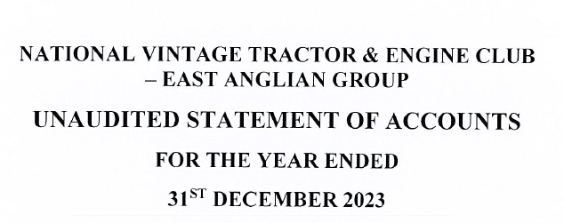
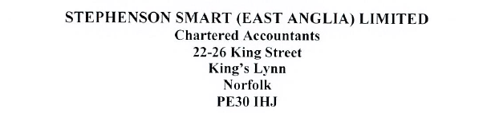
NVTEC-EA AGM 2024
Accounts from 31st December 2023

Slide 7
NVTEC-EA AGM 2024
Accounts from 31st December 2023

Slide 8
NVTEC-EA AGM 2024
Accounts from 31st December 2023

Slide 9
NVTEC-EA AGM 2024
Accounts from 31st December 2023

Slide 10
NVTEC-EA AGM 2024
Accounts from 31st December 2023

Slide 11
NVTEC-EA AGM 2024
Accounts from 31st December 2023

Slide 12
NVTEC-EA AGM 2024
Accounts from 31st December 2023

Slide 13
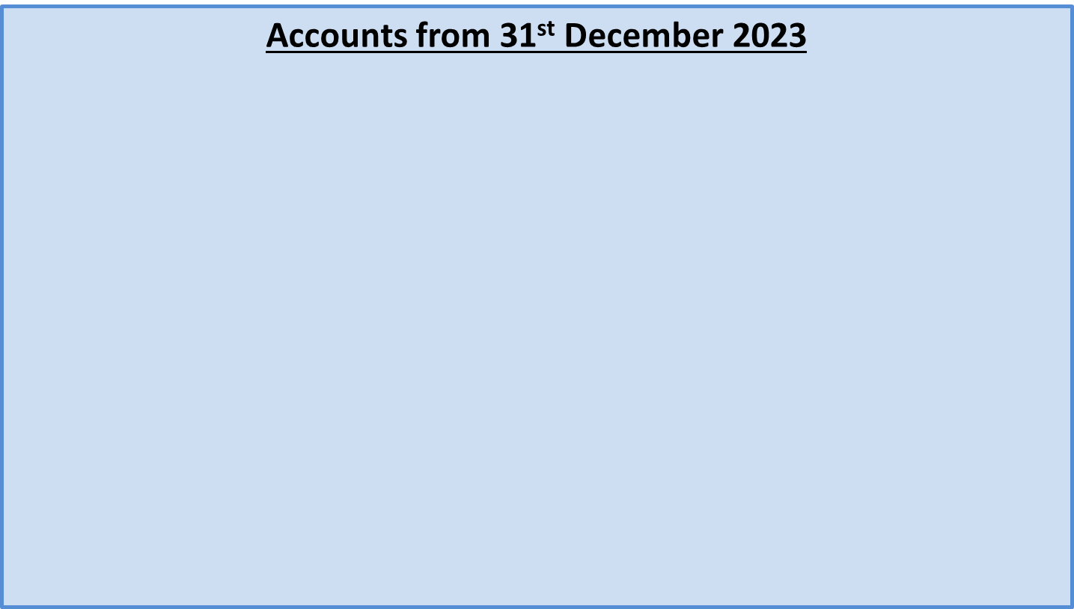
NVTEC-EA AGM 2024

Slide 14
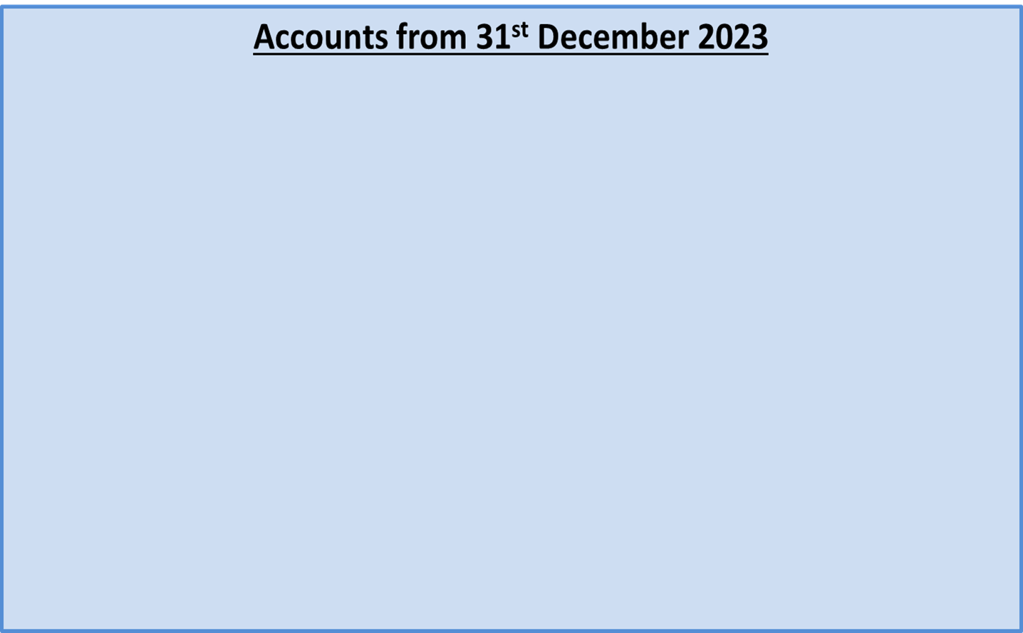
NVTEC-EA AGM 2024

Slide 15
NVTEC-EA AGM 2024
Annual General Meeting 21st November 2024
Road Run Charity Donations
MAGPAS Air Ambulance - £2,286.00
Stradsett Park Vintage Rally Charity Donations
East Anglian Air Ambulance – £5,000.00
St John Ambulance – £1,000.00
Norfolk Hospice (Tapping House) - £1,000.00
Addenbrookes Charitable Trust - £1,000.00
Brambles Animal Sanctuary (Denver) £1,000.00
Working Weekend Charity Donations
Moth in a China Shop - £2,373.00
Grand Total Raised: £13,659.00

Slide 16
NVTEC-EA AGM 2024
Annual General Meeting 21st November 2024
The following existing committee members are to stand for 2024-25:
Position | Member
Chairman | New person to be elected
Vice Chairman | Judy Webb
Secretary | Judy Webb
Membership Secretary | Claire Mycock
Treasurer | New person to be elected
Publicity Officer | Gordon Carson
Rally Organisers | Jack and Annie Dowe
Committee Members | Reg Fletcher, David Askew, Alan Whiteman, David Mycock, Malcolm Tompsett, Philip Gammon, Geoff Norman, Frank Fowler, Tom Venni, Steven Bruce, Georgie Smith and Neil Ayres.

